Slide 1
Solutions for Class test

Slide 2
Consider a Hash table of size 11 that uses division method as hash function and quadratic probing. A sequence of records with keys 43, 36, 92, 87, 11, 4, 71, 13, 14 is inserted into an initial empty hash table. What is the index into which the last record is inserted? What is the time complexity of quadratic probing ?

Slide 3
What is the minimum height of AVL tree with n nodes?

Slide 4
The post order traversal of a binary search tree with integer values produces the following sequence 7, 12, 25, 47, 89, 55, 42, 17. What is the value of the left child of the root of the tree?

Slide 5
Consider a Binary search tree containing N nodes, What is the time complexity of printing out the values stored in all of the leaf nodes in ascending order is ?

Slide 6
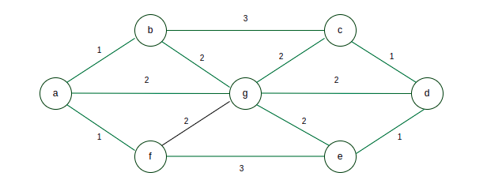

Slide 7
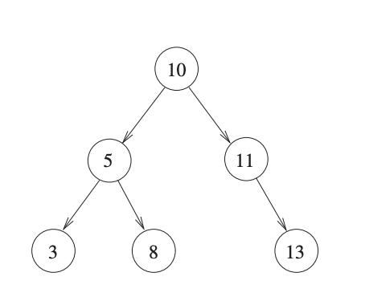
typedef struct node {
int val;
struct node *left, *right; } node;
int foo(node *p) { int retval;
if (p == NULL) return 0;
else { retval = p->val + foo(p->left) + foo(p->right); printf("%d ", retval);
return retval; } }

Slide 8
A DFS of a directed graph generally produces the exact number of edges of a tree, i.e., not dependent on the order in which vertices are considered for DFS.

Slide 9
A Depth-First Search (DFS) of a directed graph can produce a different number of tree edges depending on the order in which vertices are considered for the DFS. The number of tree edges in a DFS tree depends on the specific traversal path taken during the DFS.
During a DFS, starting from a particular source vertex, the traversal explores the graph by visiting neighboring vertices in a systematic way. The order in which the neighboring vertices are visited impacts the formation of the DFS tree.

Slide 10
Calculating minimum and maximum number of nodes from height:

Slide 11
The height of a tree is the length of the longest root-to-leaf path in it. The maximum and the minimum number of nodes in a binary tree of height 5 are:

